Slide 1
Ecopilot
Smart Estimation · Informed Decisions · Optimal Planning
presentators:成诺鑫 赵天舒
team members：成诺鑫 赵天舒 姚卓鑫 Jonathan Vigin

Slide 2
www.www.2ppt.com.com/hangye
Content
01
Project
Overview
02
Project
Environment
02
Module
Features
Technical
Points
04

Slide 3
PART.01
Project Overview
In this section, we will introduce the project at a macro level

Slide 4
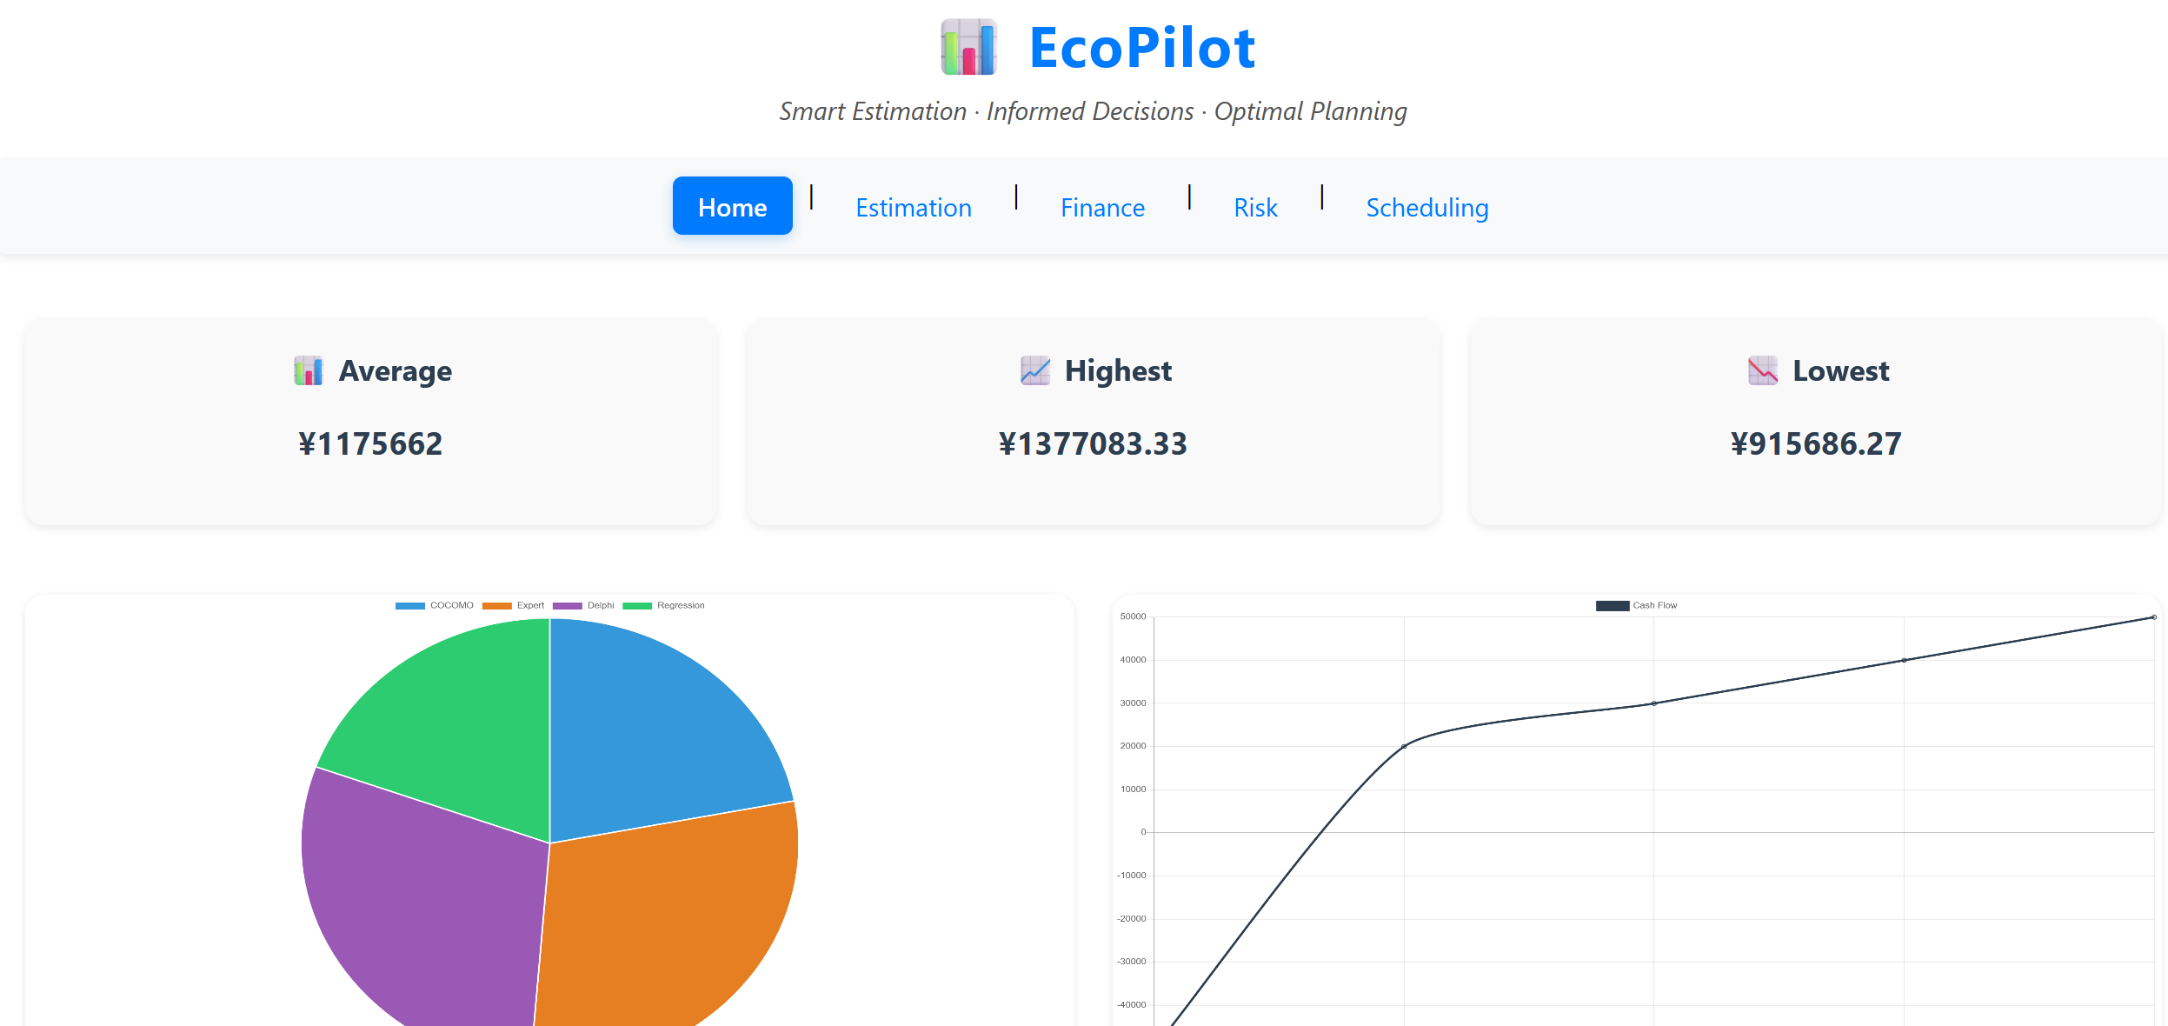
Project overview
What
Web tools for economic analysis and decision-making
Estimation&Finance&Risk&Scheduling
Who
Anyone who needs to do an economic task and has the most basic Internet skills
Software project manager,Economic analyst, team members,etc
How
Users only need to input the parameters of their actual project into the required model tool, and can get the corresponding results

Slide 5
PART.02
Project Environment
In this section, we will introduce the project environment

Slide 6
Project Environment
Frontend
vue
Backend
python
fastapi

Slide 7
PART.03
Module Features
In this section, we will introduce four module features and their interface

Slide 8
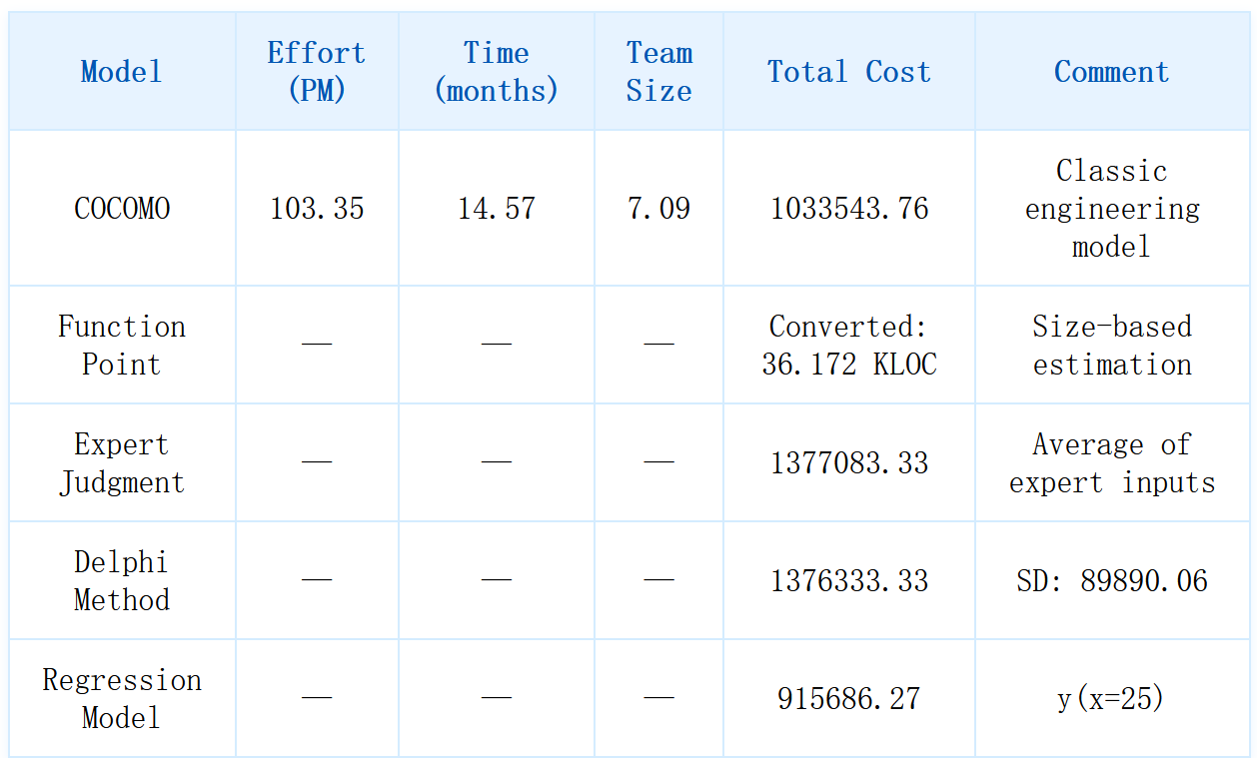

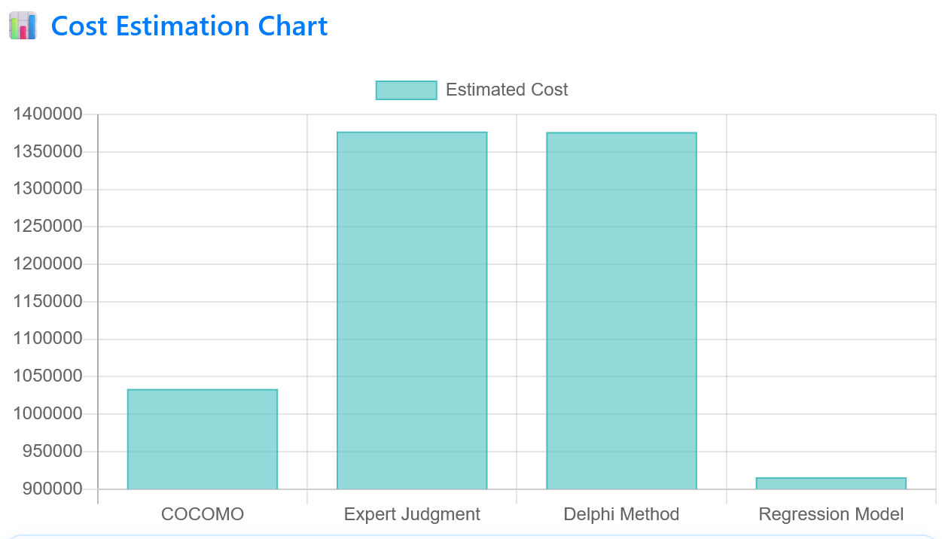

1
Estimation
2
Finance
3
Risk
4
Scheduling
Expert Judgement
Delphi Method
Regression Model
COCOMO
Function point analysis
Notes:
we have four core modules

Slide 9
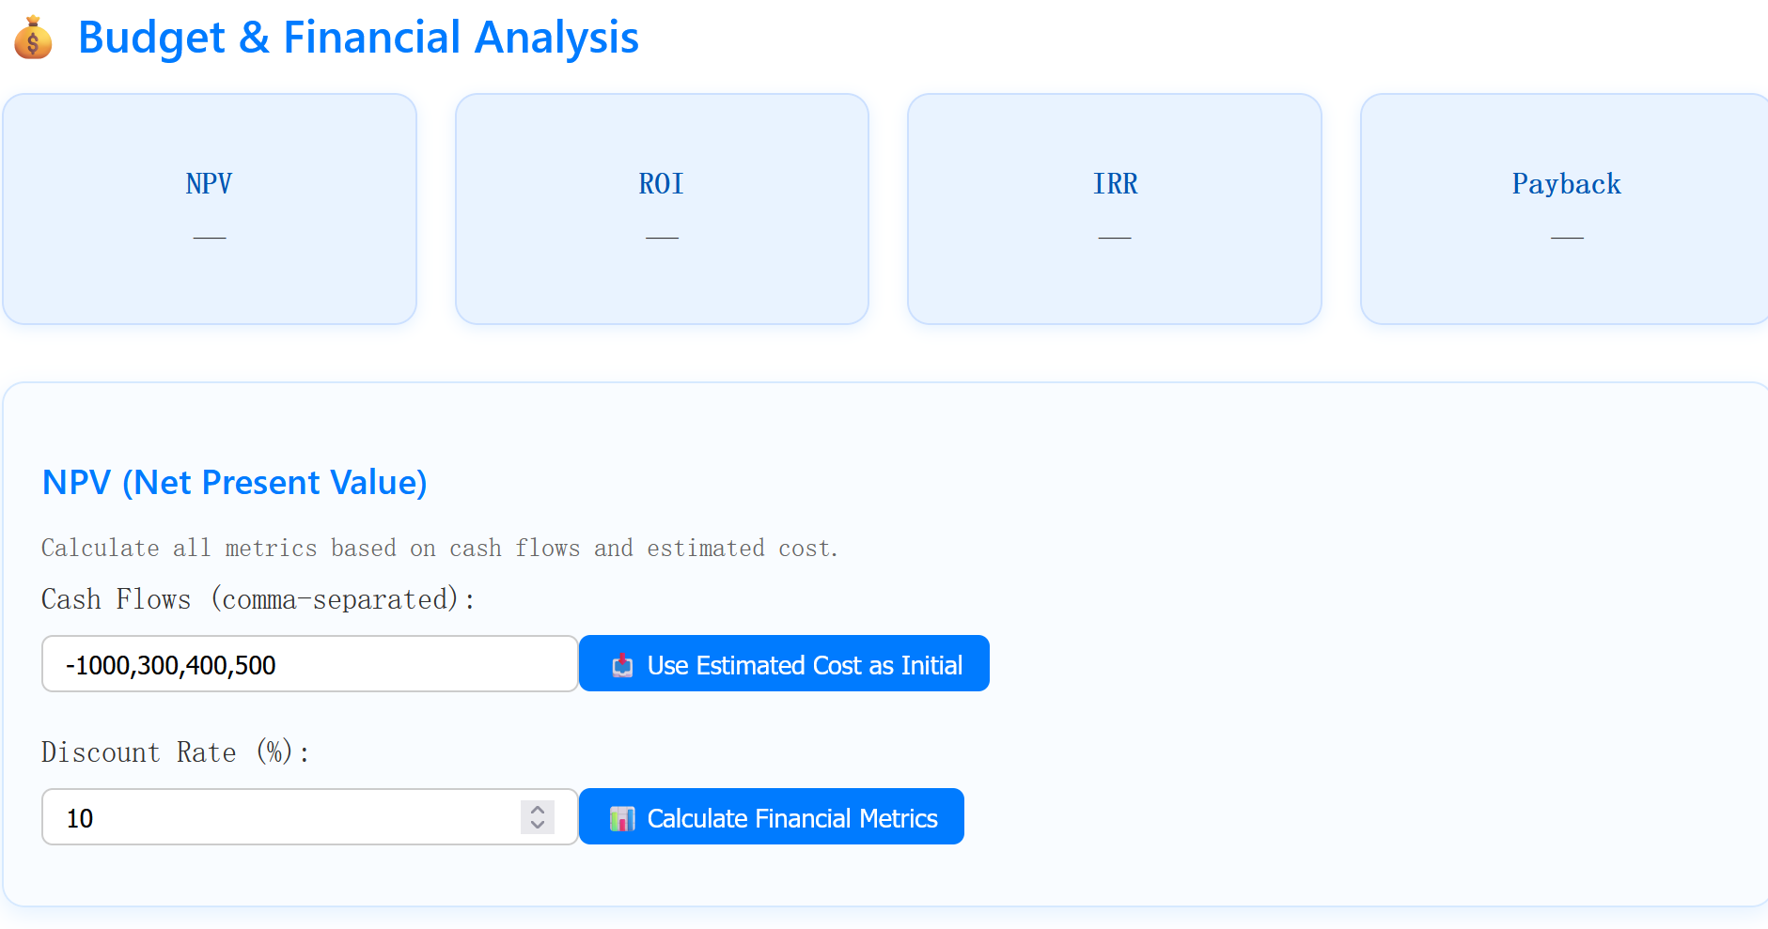
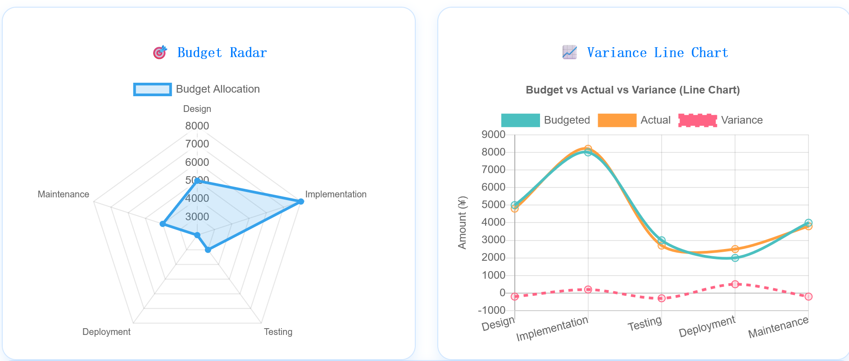
1
Estimation
2
Finance
3
Risk
NPV
ROI
IRR
Payback
Budget Tracking
Variance Analysis
Forecast Result
4
Scheduling

Slide 10
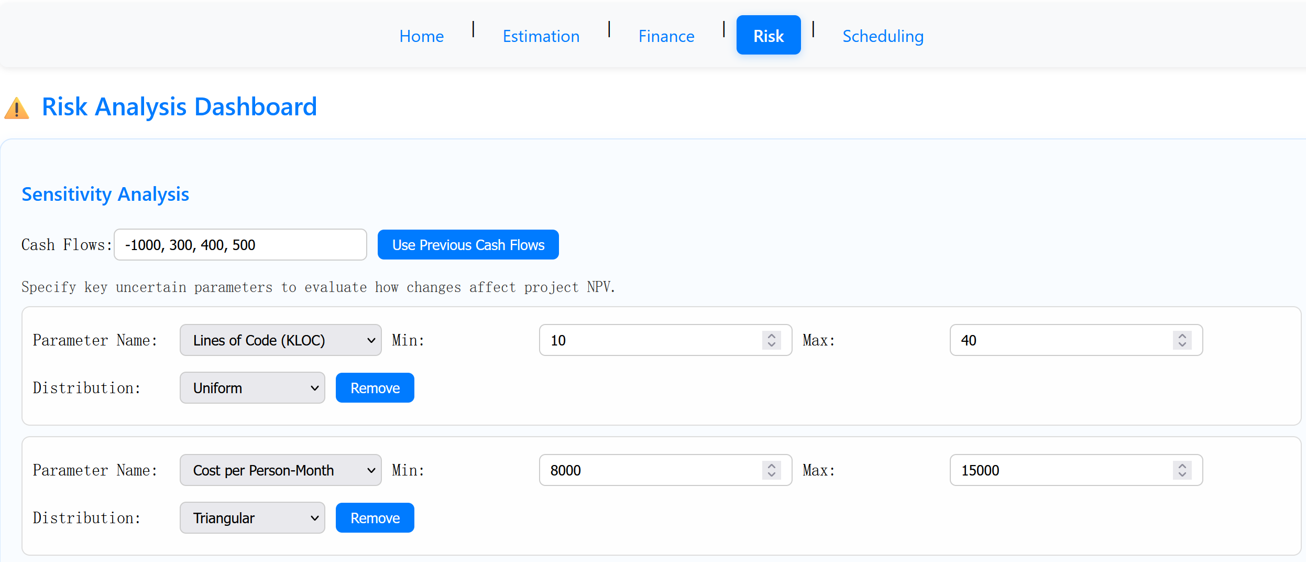
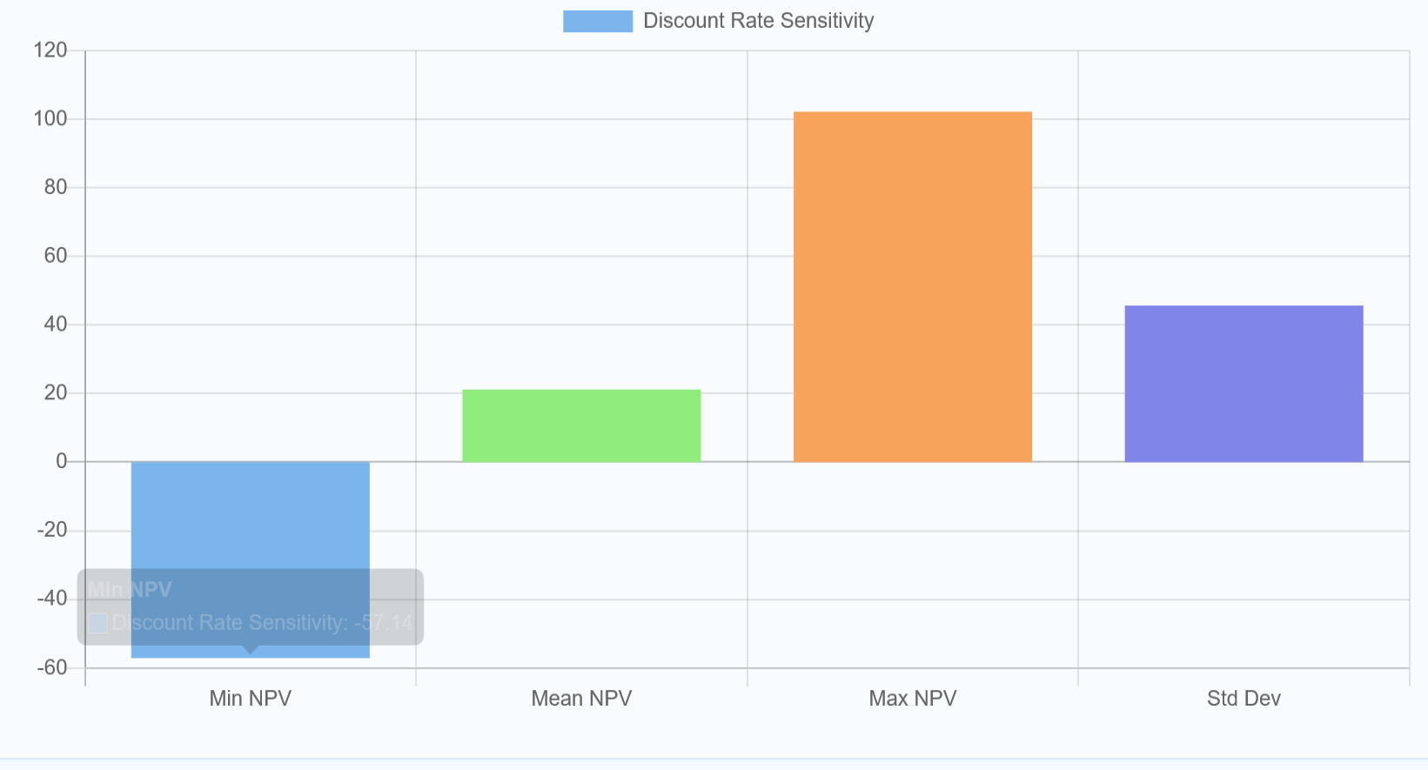
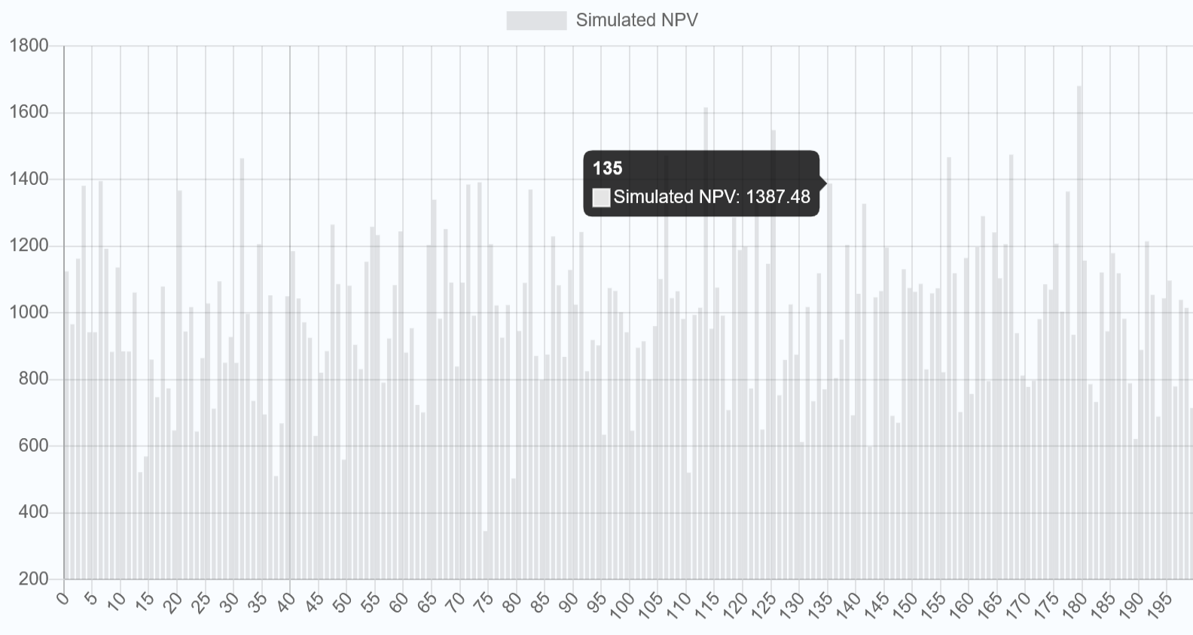
1
Estimation
2
Finance
3
Risk
4
Sensitivity Analysis
Decision Trees
Monte Carlo Simulation for uncertainty modeling
Scheduling

Slide 11
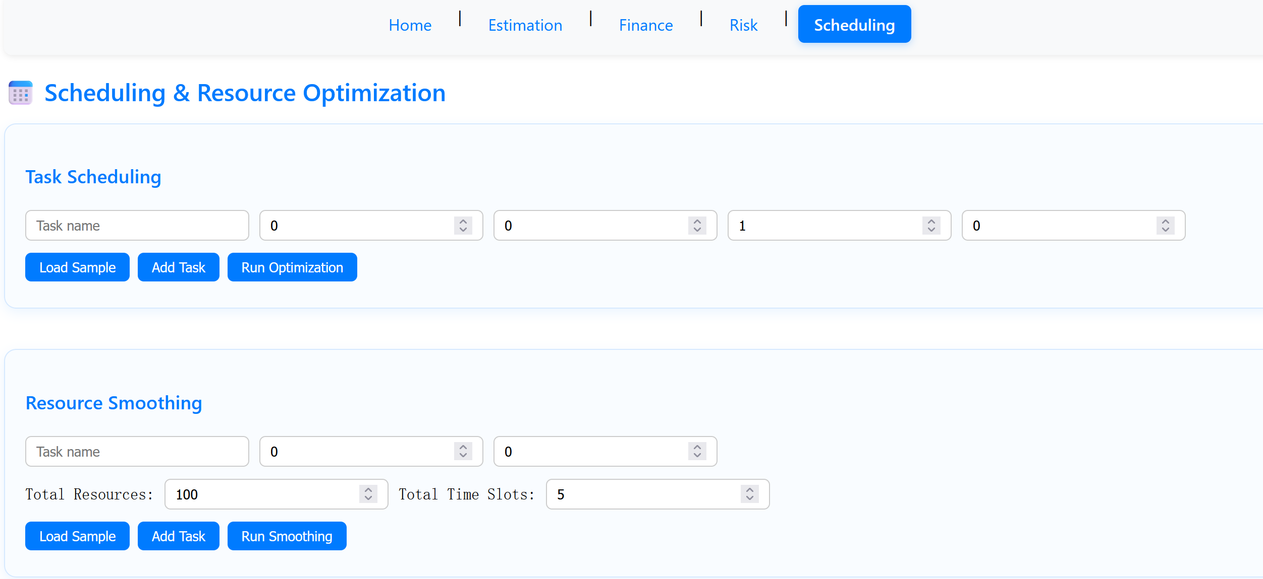
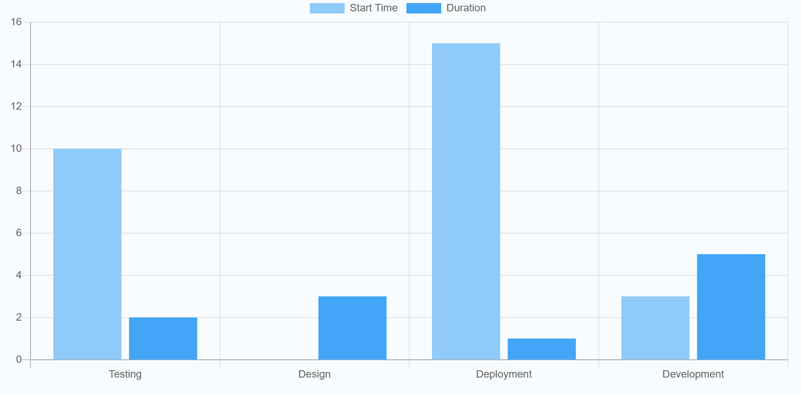
1
Estimation
2
Finance
3
Risk
4
Scheduling
resource leveling
resource smoothing algorithms

Slide 12
PART.04
Technical Points
In this section, we will introduce the algorithm in our project

Slide 13


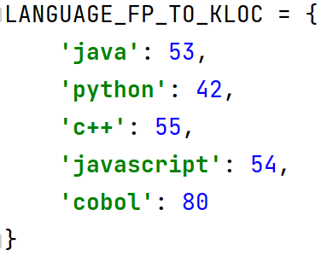
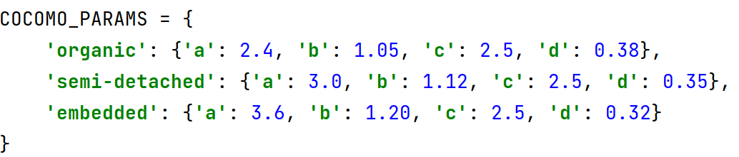
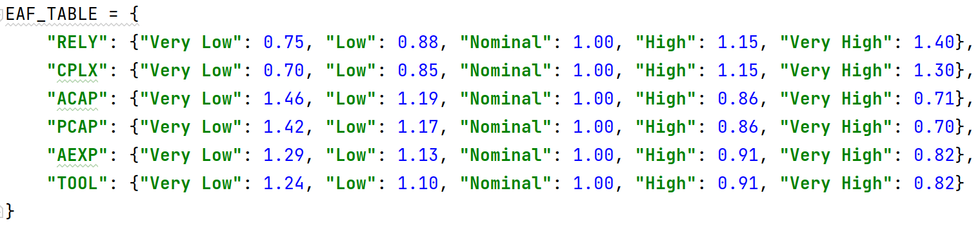
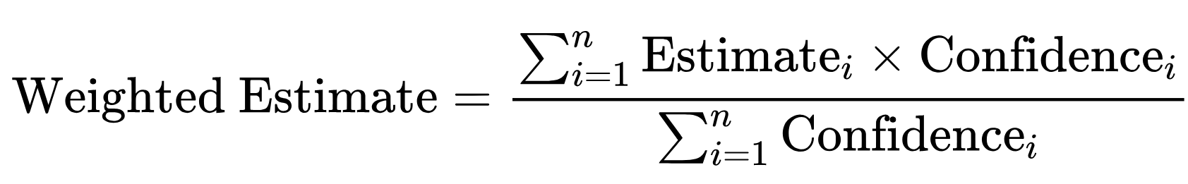
Estimation
Empirical
Formula
Function Point
KLOC
Parameter
COCOMO
Heuristic
Expert Judgment
Delphi
Multiple Rounds
Analytical
Regression
Data-rich organizations

Slide 14
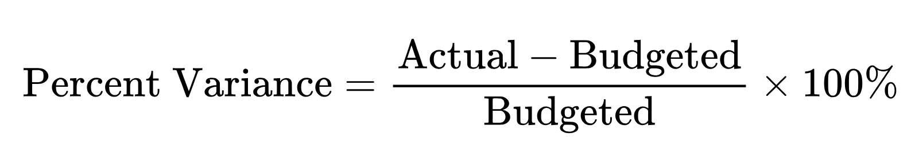
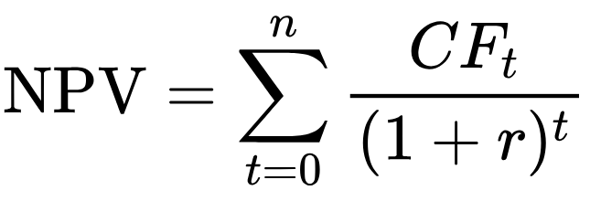
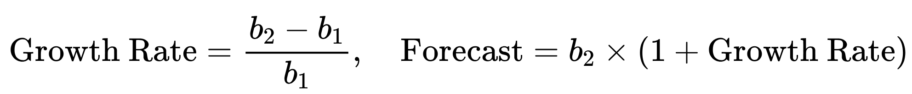
Finance
Budget Tracking
Variance Analysis
NPV : the present value of a series of future cash flows discounted by a given rate.
ROI : the efficiency of an investment by comparing gain and cost.
IRR : the discount rate that makes NPV = 0
Payback period : the time needed for cumulative cash flows to cover the initial cost.
+10% → Overspent
< −10% → Underspent
else → Within range
Forecast

Slide 15
Risk
2. Decision Tree
Approach:
Analyze outcomes with different probabilities to guide rational choices.
1. Sensitivity Analysis
Approach:
Vary one parameter at a time across its range
Keep others fixed in base_context
Compute impact on NPV
Result Metrics:
Min NPV
Max NPV
Mean NPV
Std Dev of NPV
3. Monte Carlo Simulation
Inputs:
Base estimate
Standard deviation
Distribution (Normal / Triangular)
Number of iterations
Outputs:
Mean, Min, Max, Std of simulated outcomes
Loss probability
High-return (>120%) probability

Slide 16
Scheduling
Greedy Scheduling
Purpose: Efficiently assign tasks to time slots by prioritizing high-priority tasks and avoiding early-time blockage by less urgent ones.
Key Features:
Tasks sorted by priority (↓) and deadline (↑).
Each task is assigned to the earliest available feasible slot within its time window.
Avoids overbooking early time slots with low-priority work.
Output: List of scheduled tasks with start, end, and any unassigned ones.

Slide 17
Scheduling
Resource Smoothing
Purpose: Evenly distribute task workload over flexible time ranges while respecting resource limits.
Key Features:
Each task has workload and flexibility
Algorithm allocates task load across multiple time slots to avoid resource spikes.
Ensures each slot's resource usage stays within ~120% of average per-slot capacity.
Output: Task-to-slot mapping with per-slot load.

Slide 18
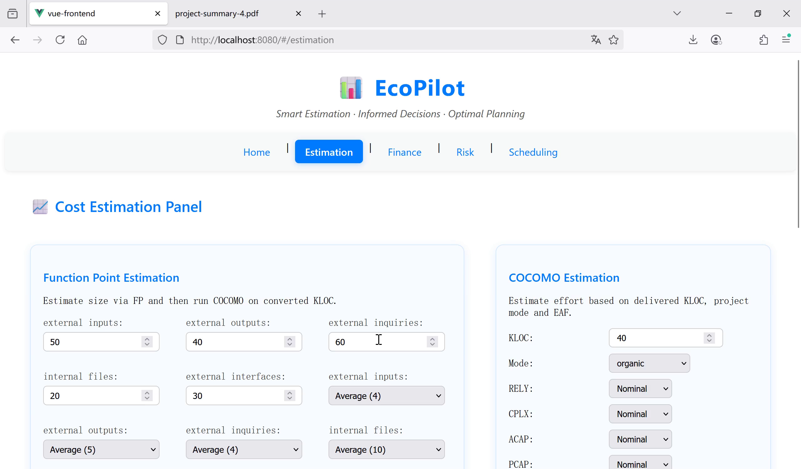

Slide 19
Ecopilot
THANK YOU !
presentators:成诺鑫 赵天舒
team members：成诺鑫 赵天舒 姚卓鑫 Jonathan Vigin

